Slide 1
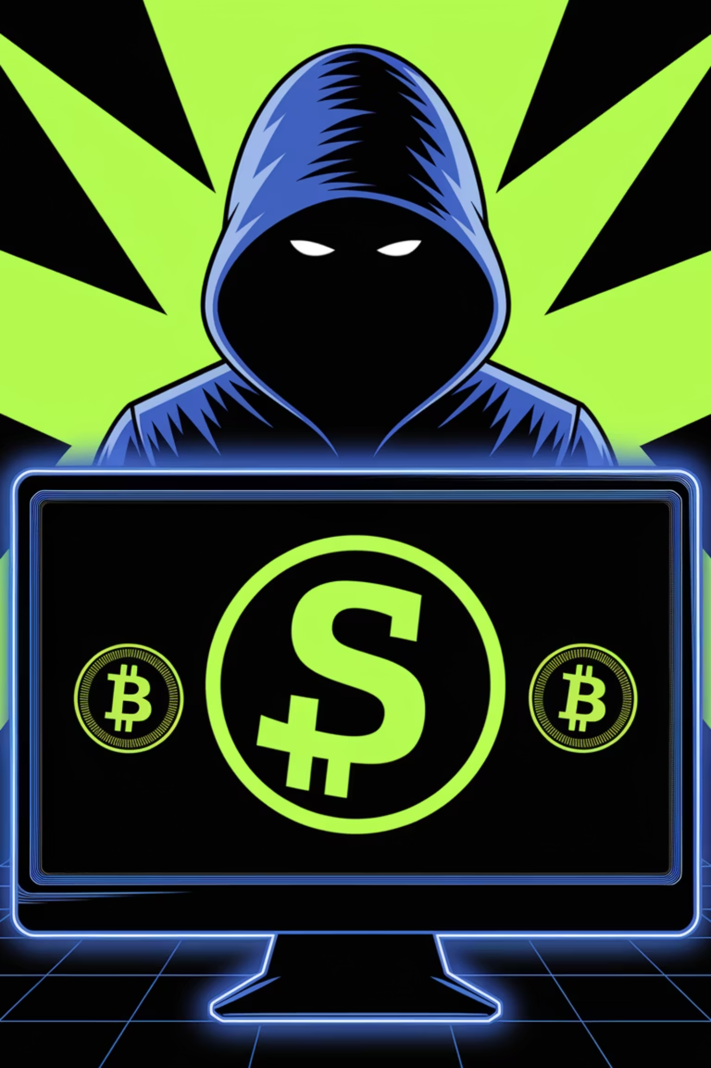
The Silk Road: Birth of a Dark Web Empire
By: Dennis Freyman

Slide 2
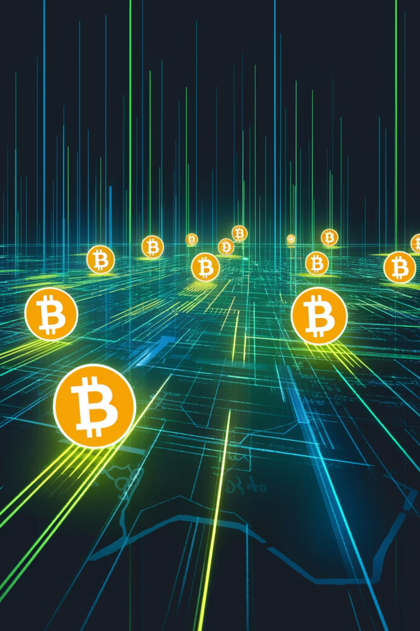



Technological Foundations
Tor Network
Bitcoin Transactions
Pioneering Platform
Silk Road operated on the Tor network. This technology concealed users' locations and identities through multiple encryption layers.
The site exclusively used Bitcoin. This cryptocurrency enabled anonymous payments without traditional banking systems.
As one of the first large-scale darknet markets, Silk Road established the blueprint for future underground marketplaces.

Slide 3
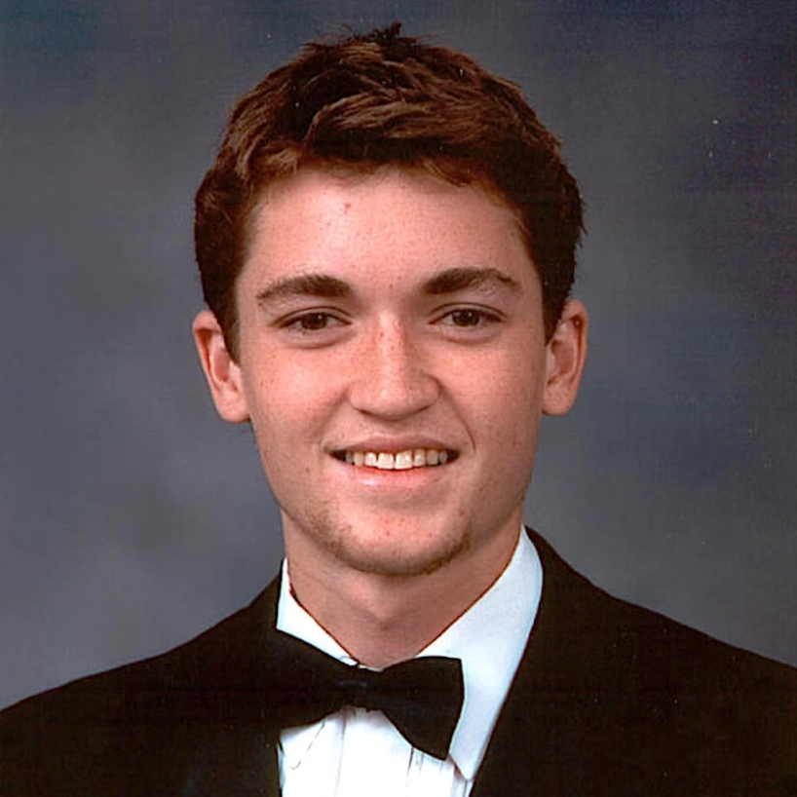
The Man Behind the Curtain
The Founder
The Pseudonym
The Significance
Ross Ulbricht, a former Eagle Scout and physics graduate, created Silk Road as a libertarian economic experiment. He believed in free markets and personal liberty.
Ulbricht adopted the alias "Dread Pirate Roberts" (DPR). The name referenced a character from The Princess Bride movie and novel.
In the film, the Dread Pirate Roberts was a title passed between different people. This implied the Silk Road leadership could change hands.

Slide 4
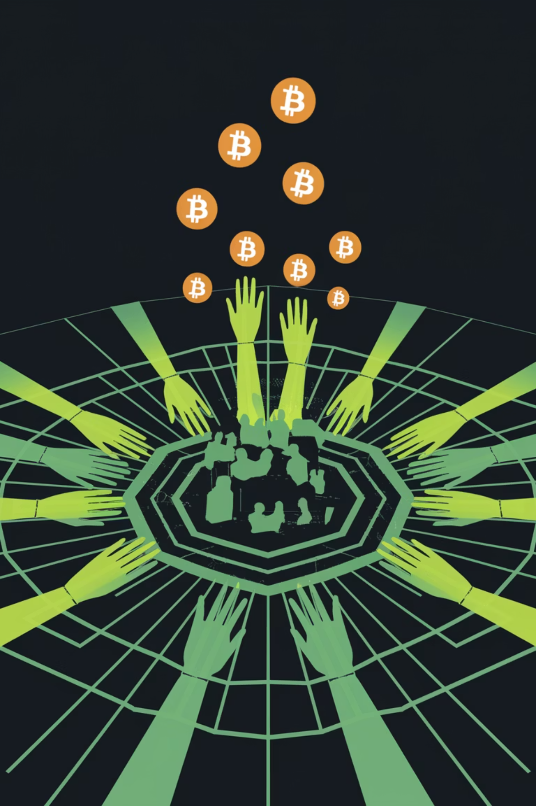
Silk Road's Rapid Growth
100K+
$1.2B
Active Users
Total Sales
By 2013, Silk Road had attracted over 100,000 registered users. The platform expanded faster than anyone predicted.
The marketplace facilitated transactions worth $1.2 billion. This generated millions in commission fees for Ulbricht.
70%
Drug Listings
Though it sold legal items too, most products were illicit drugs. These ranged from cannabis to prescription medications and hard drugs.

Slide 5
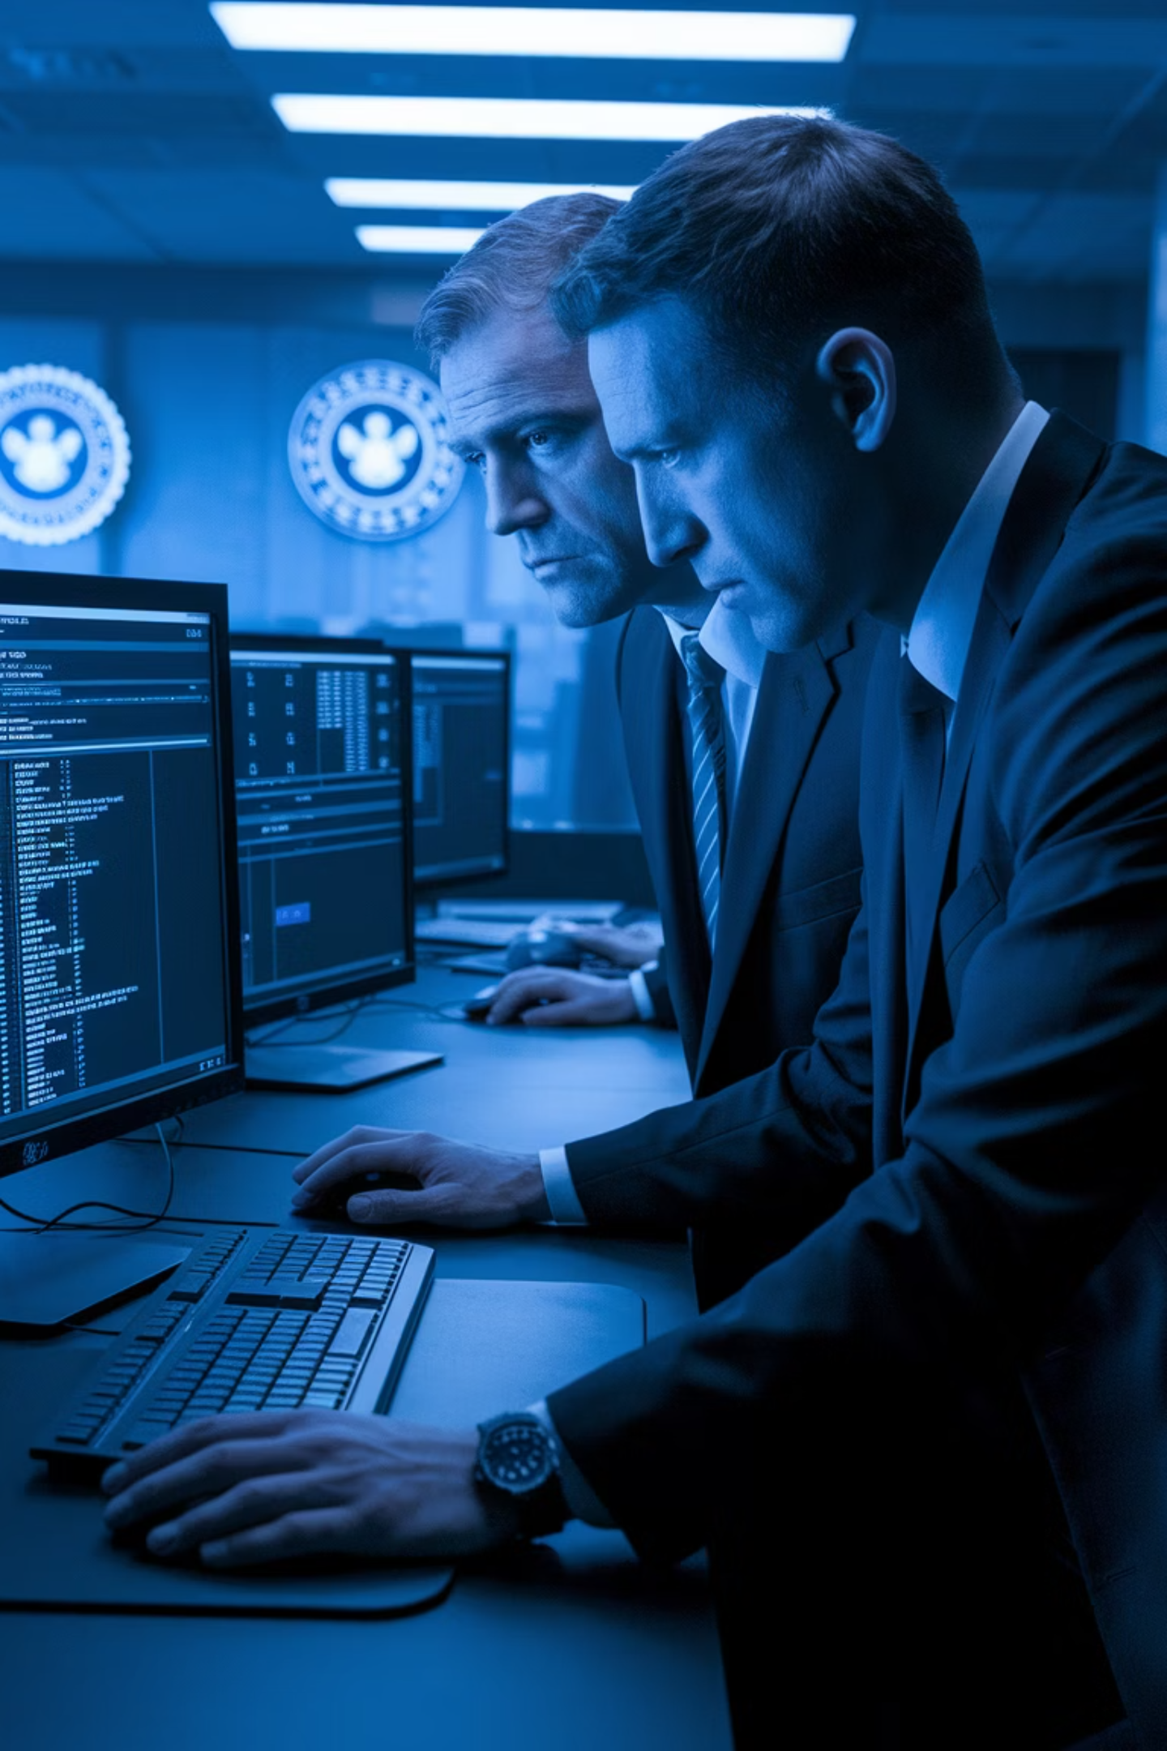

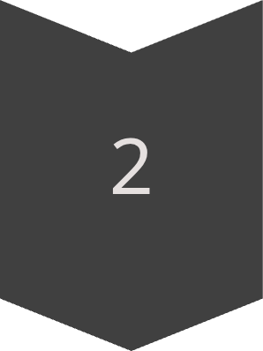

The First Mistake
Despite meticulous digital safeguards, Ulbricht made a catastrophic error early in Silk Road's existence
An anonymous user named "altoid" sought software developers for a "venture"
Seemingly trivial mistake would later prove to be the key to unraveling the entire operation.

Slide 6
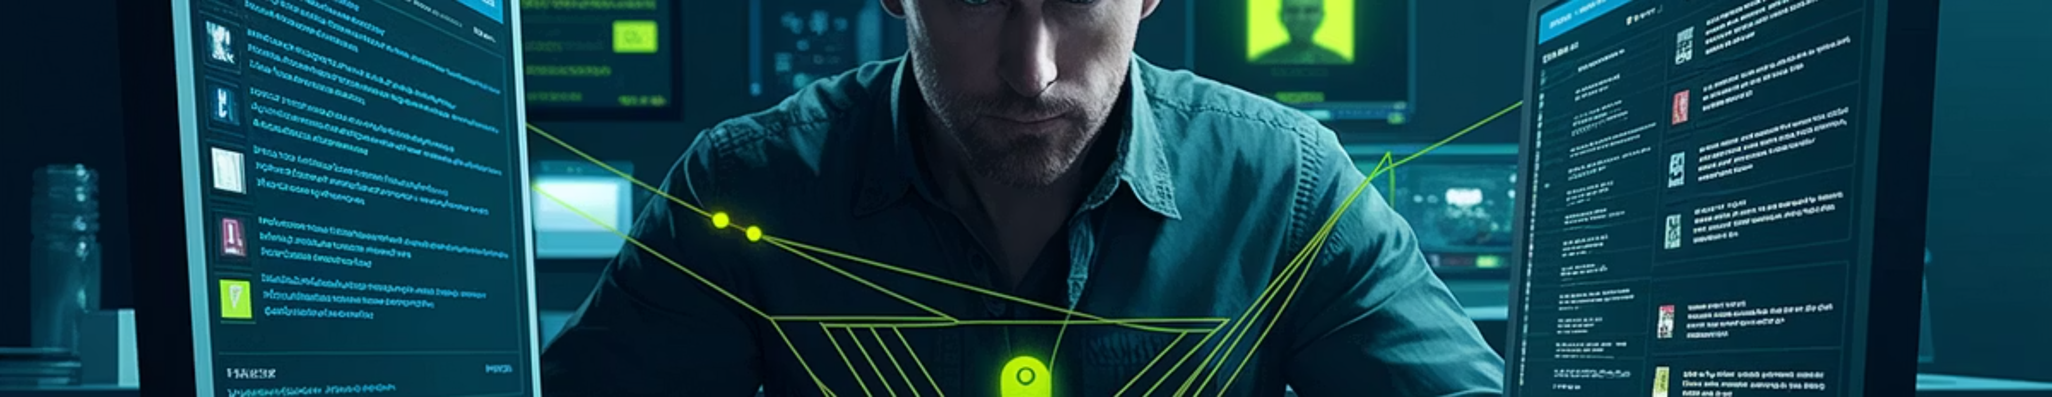
Investigation Breakthrough: OSINT
Gradually, they uncovered financial trails
Link anonymous wallet addresses back to known cryptocurrency exchanges
The FBI turned to blockchain analytics
I OSINT proved crucial

Slide 7
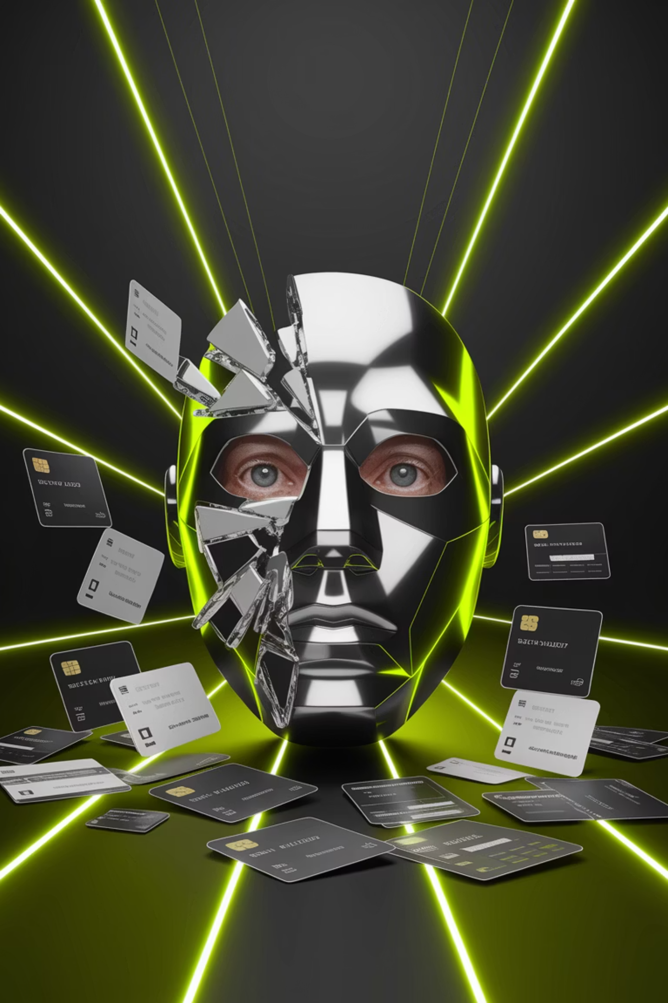
The Server Leak
1
Silk Road login page inadvertently exposed its real IP address
2
Full forensic image
He used counterfeit IDs with his real photo. This careless mistake linked his identity to Silk Road infrastructure.

Slide 8
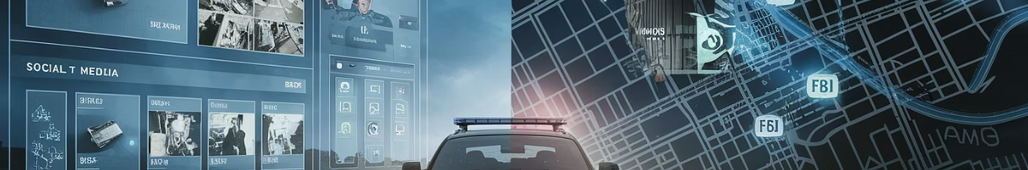
Building the Case
Monitored Ulbricht's online activity
1
2
Physical surveillance
track physical movements
san francisco
Libraries and Cafes
3
Posslble arest location?

Slide 9
Glen Park Library
San Francisco’s Glen Park Library
1
FBI agents located Ulbricht . They waited for him to log into the Silk Road admin panel.
The Critical Moment
2
They caught him logged in as administrator. This prevented him from encrypting or deleting crucial evidence.
The Distraction
3
Two agents posed as arguing lovers.

Slide 10



Forensic Goldmine
Massive Asset Seizure
Authorities confiscated 144,000 Bitcoins. This cryptocurrency cache was worth $28.5 million at the time of seizure.
2
Marketplace Shutdown
The FBI immediately took Silk Road offline. They replaced the site with a seizure notice that shocked the darknet community.
1
Media Sensation
The case generated unprecedented public interest. It introduced many to concepts like the dark web and Bitcoin.
3

Slide 11
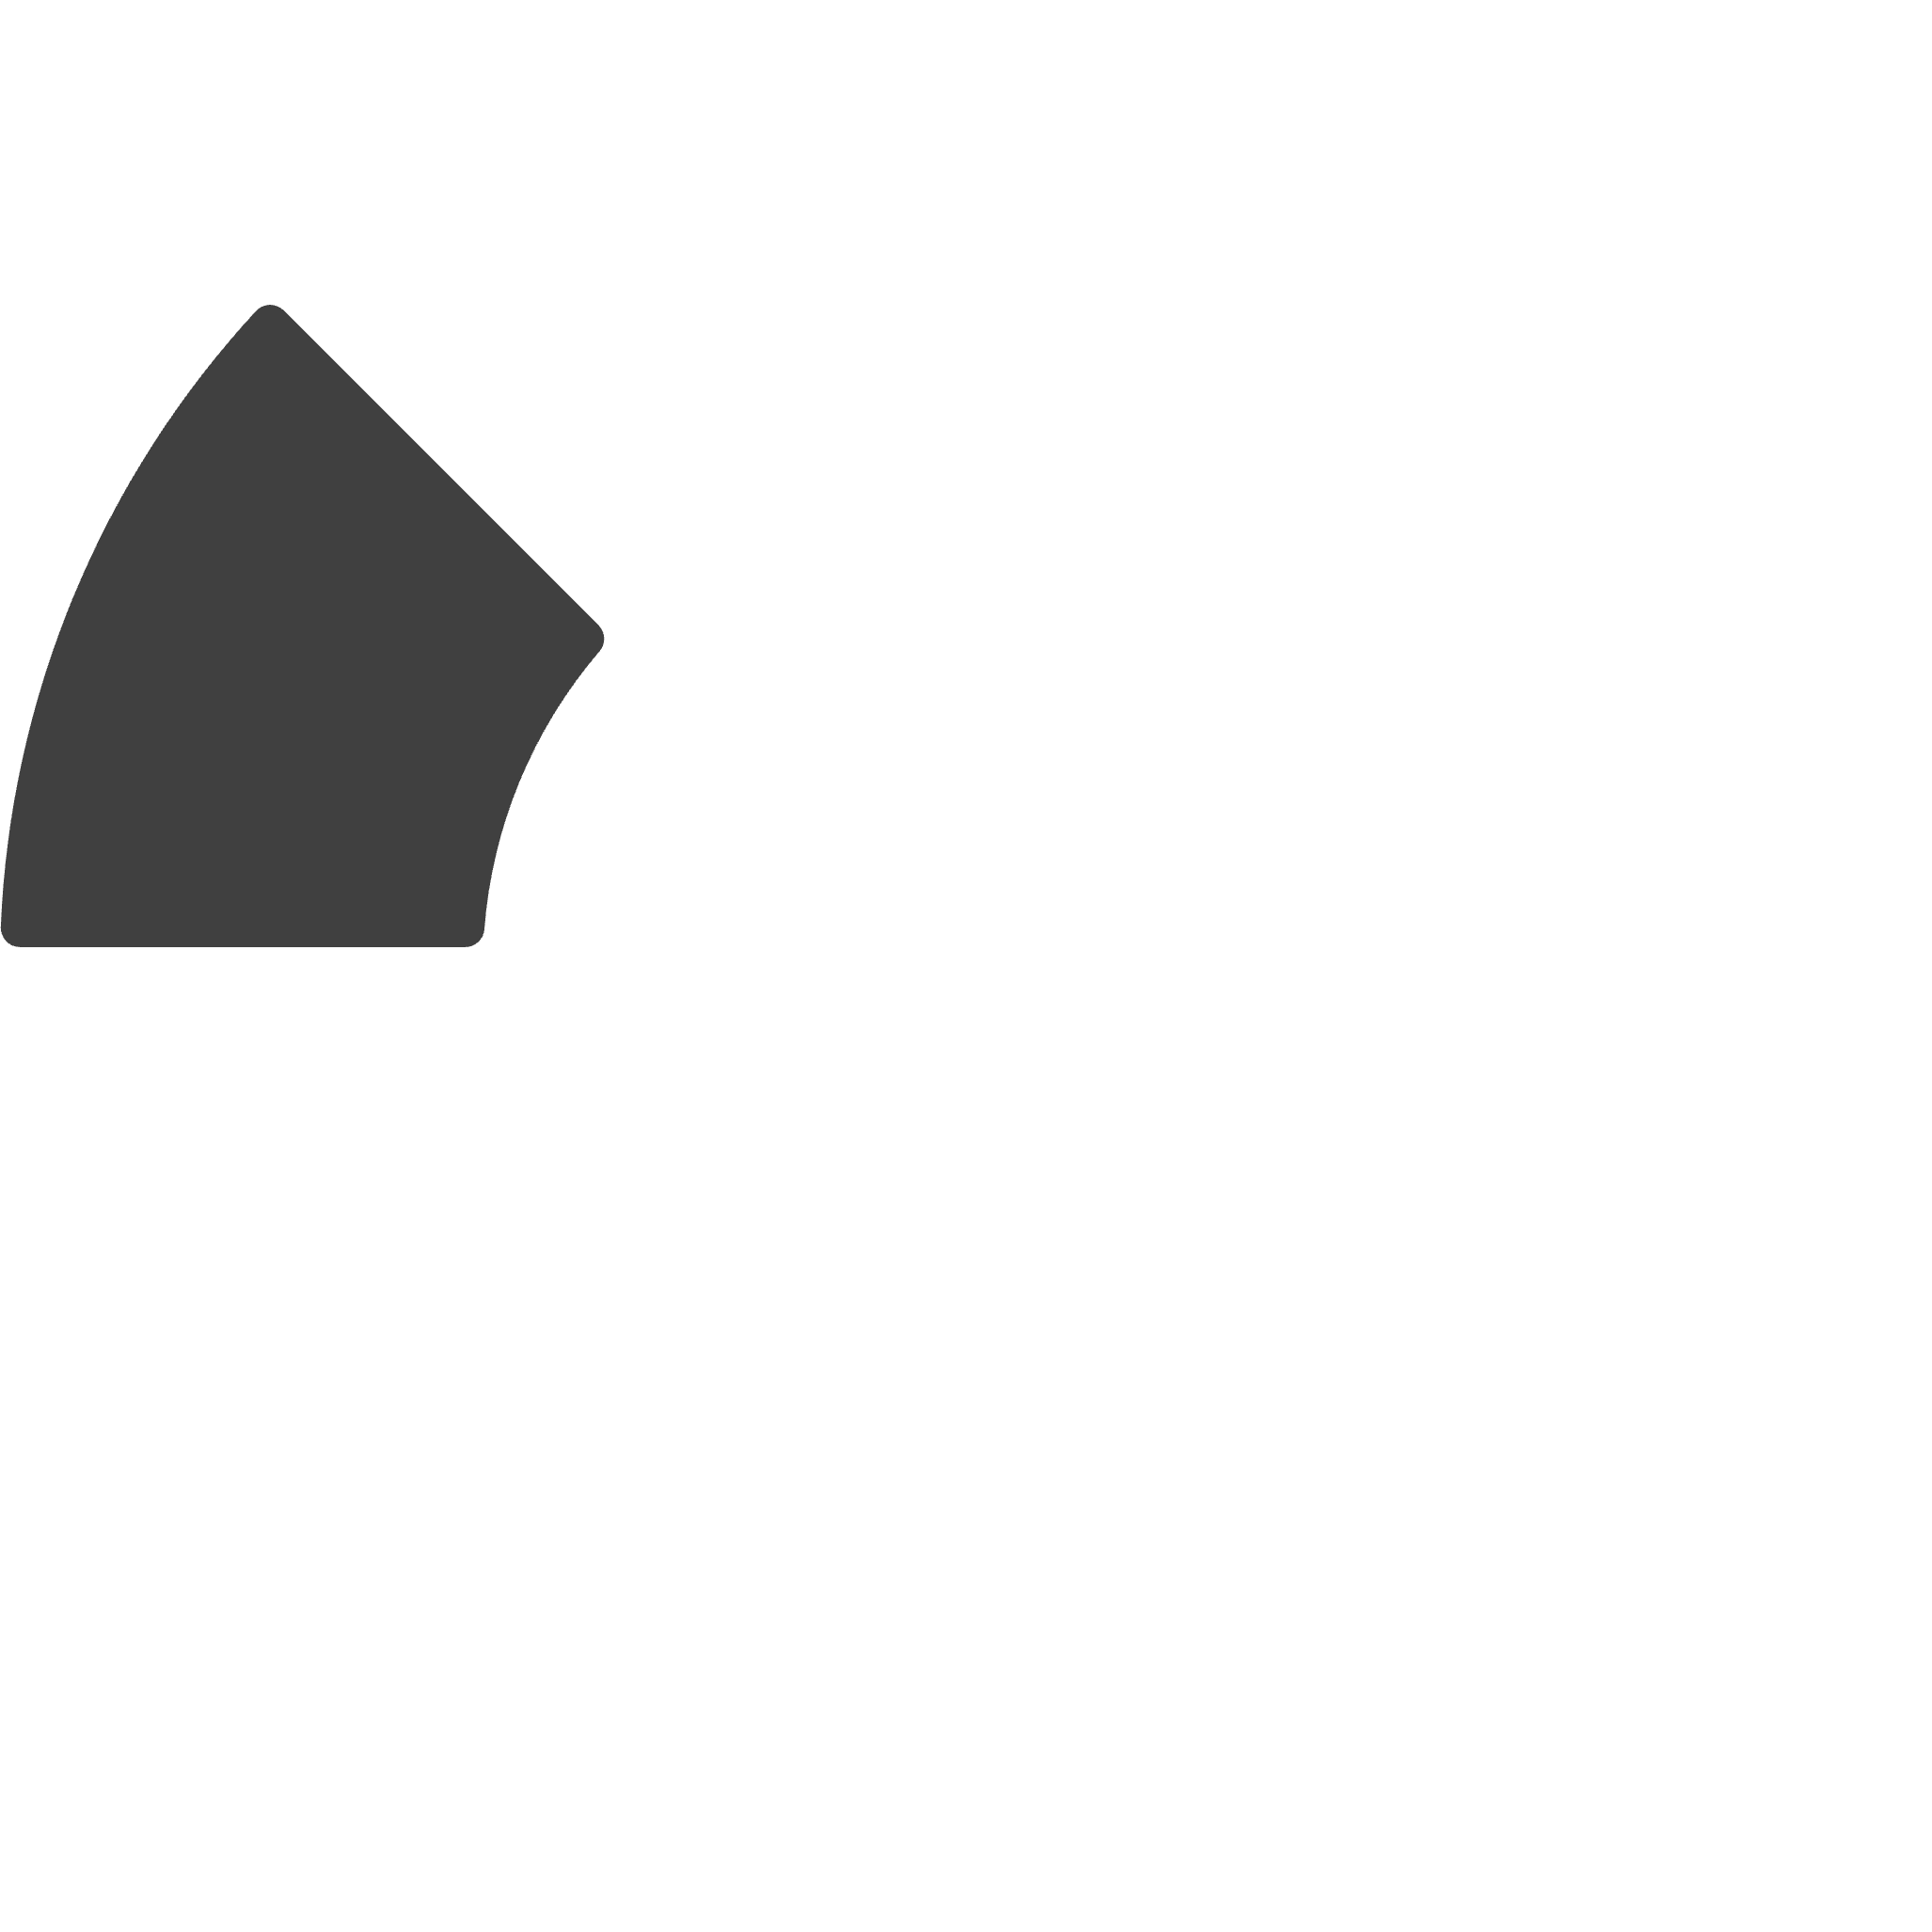


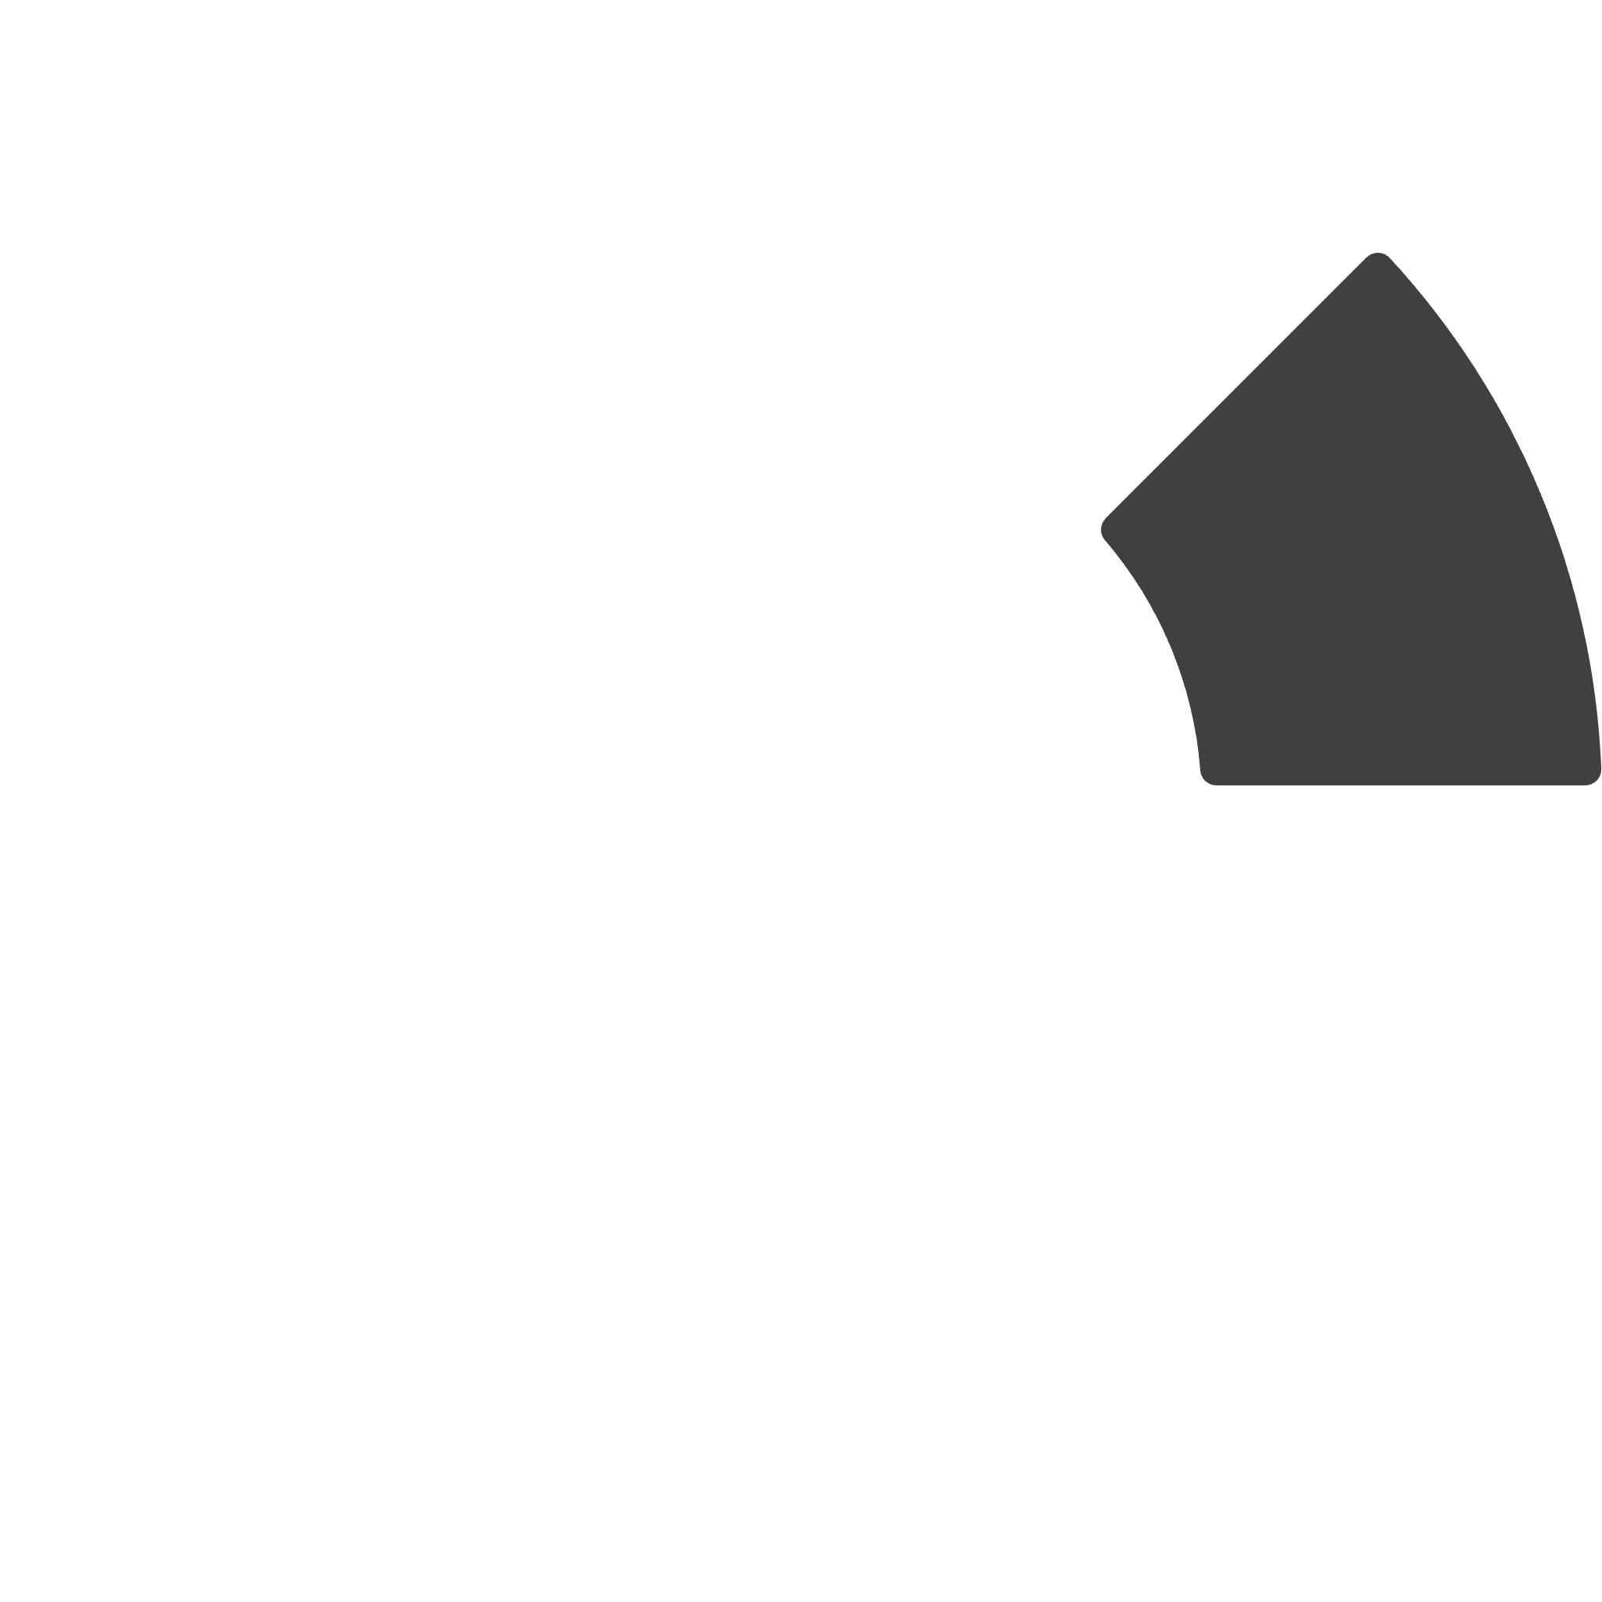
Legal Proceedings
Defense Strategy
Key Evidence
Trial Commencement
Criminal Charges
2
3
1
4

Slide 12




The Verdict and Sentencing
Guilty Verdict
1
Jury convicted on all seven charges
Life Without Parole
2
The court imposed the maximum sentence
Controversial Penalty
3
Many viewed it as excessive
Deterrence Message
4
Intended to warn others

Slide 13


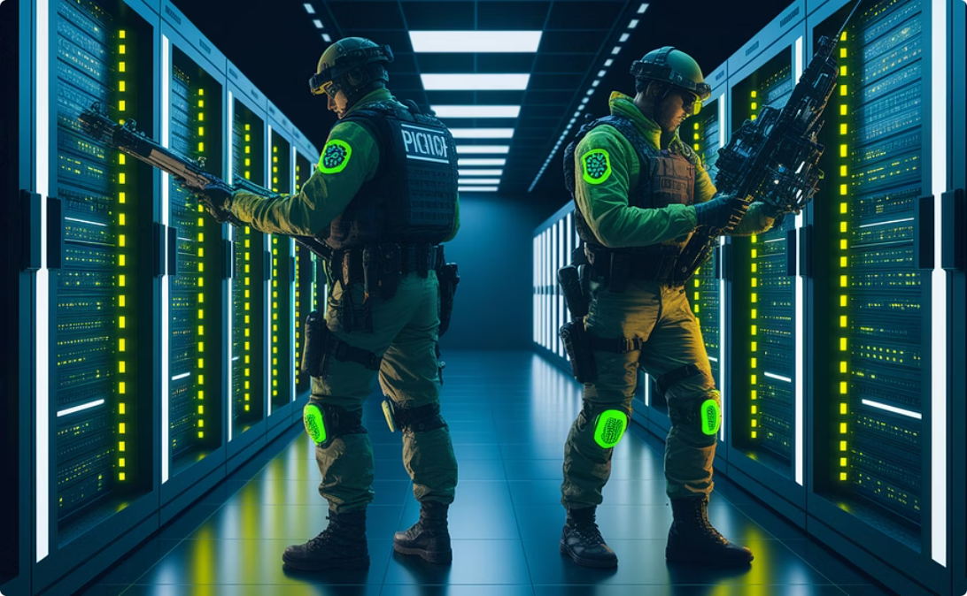
Legacy of Silk Road
Privacy Debate
Darknet Evolution
Enforcement Challenges

Slide 14
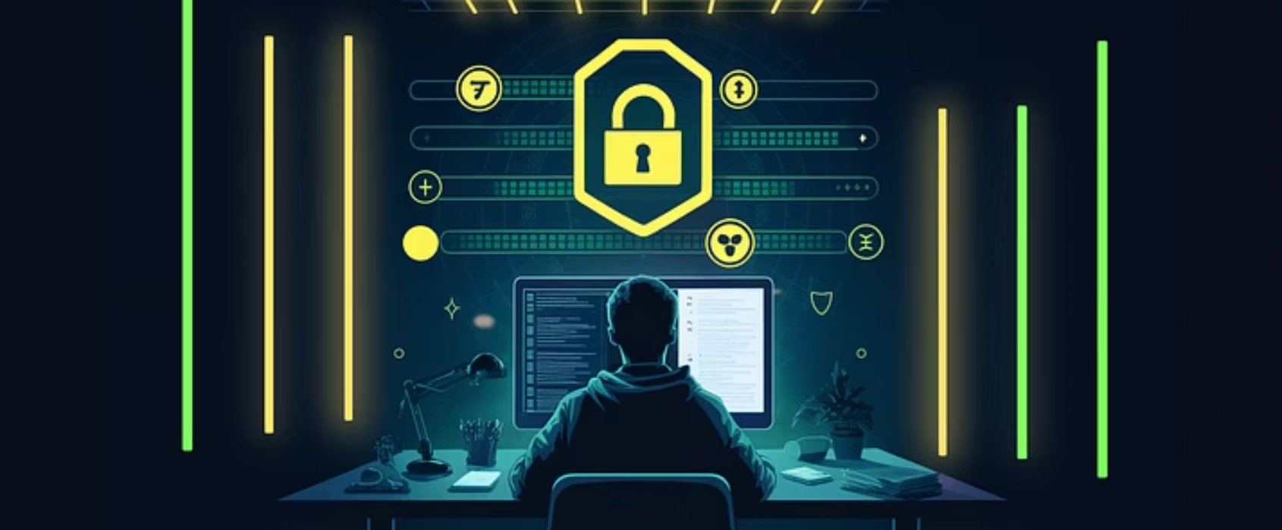
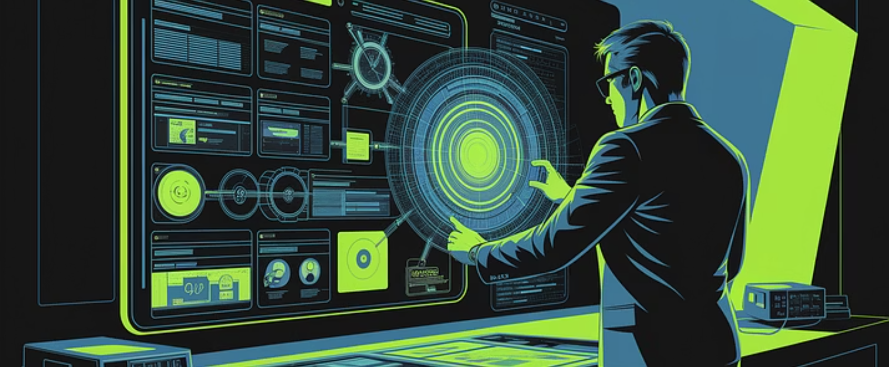

Lessons Learned - Humans

Slide 15
